Slide 1


HydroServer A Platform for Publishing Space-Time Hydrologic Datasets
CUAHSI
HIS
Sharing hydrologic data
http://his.cuahsi.org/
Jeffery S. Horsburgh
David G. Tarboton, Kimberly A. T. Schreuders, David R. Maidment, Ilya Zaslavsky, and David Valentine
And the Rest of the CUAHSI HIS Team
Support
EAR 0622374

Slide 2
From the NSF WSC Call for Proposals
“Inclusion of Data Management Plan Required”
“All Category 2 proposals must include a data management plan in the "Supplementary document" section that describes how metadata and data collected as part of their project will be disseminated to the broader community as well as plans for longer term archival of these data. All data collected by Category 2 projects funded through this solicitation will be freely and openly available to any interested investigator as soon as practical, but no later than 12 months following collection. Where possible, all PIs are strongly encouraged to use existing data centers and data portals to archive and disseminate their data (e.g. HIS for hydrologic data, NCEAS Data Repository for ecological data, BCO-DMO for Biological and Chemical Oceanography data). “

Slide 3
CUAHSI HIS
The CUAHSI Hydrologic Information System (HIS) is an internet based system to support the sharing of hydrologic data. It is comprised of hydrologic databases and servers connected through web services as well as software for data publication, discovery and access.
Data Discovery and Integration platform
HIS Central
Like search portals Google, Yahoo, Bing
Metadata Services
Metadata Search
Service registration
Service and data theme metadata
Catalog harvesting
Data carts
HydroServer
Data Services
HydroDesktop
Data Publication platform
Water Data Services
Data Synthesis and Research platform
Spatial Data Services
Like web servers
Like HTML
Like browsers

Slide 4
HydroServer Goals
A platform for publishing space-time hydrologic datasets that:
Provides local control of data
Makes data universally available
Is autonomous – e.g., functional independent of the rest of HIS

Slide 5
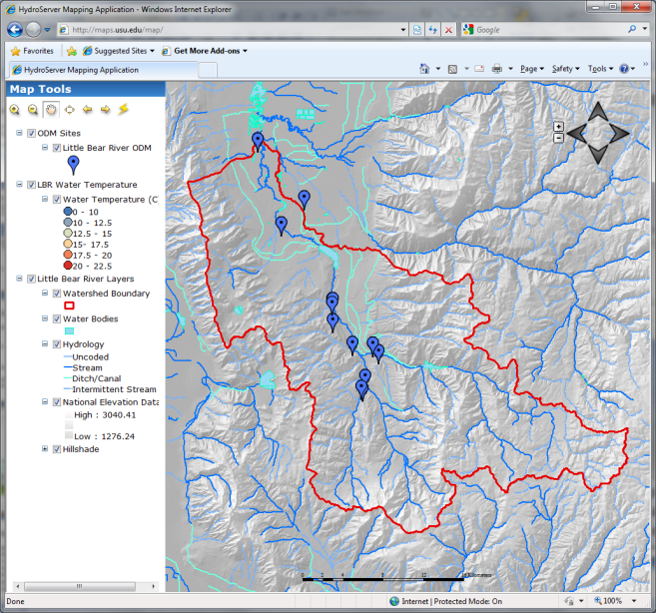
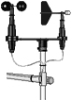
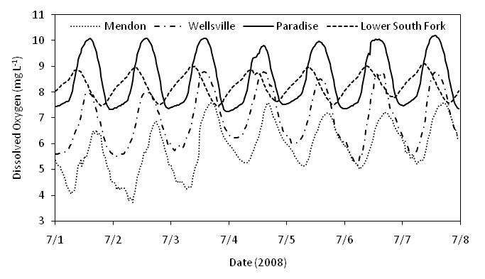
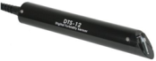
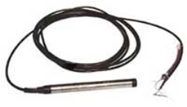
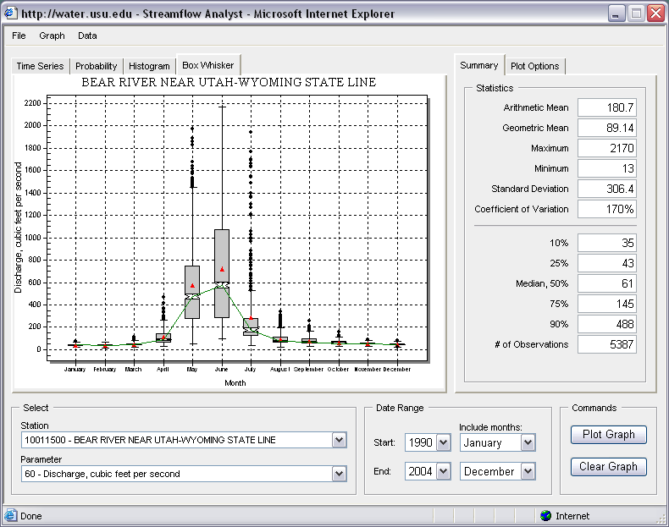
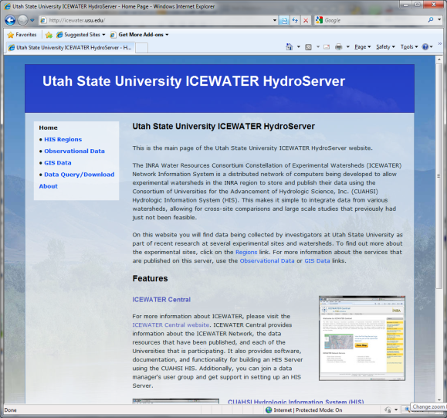

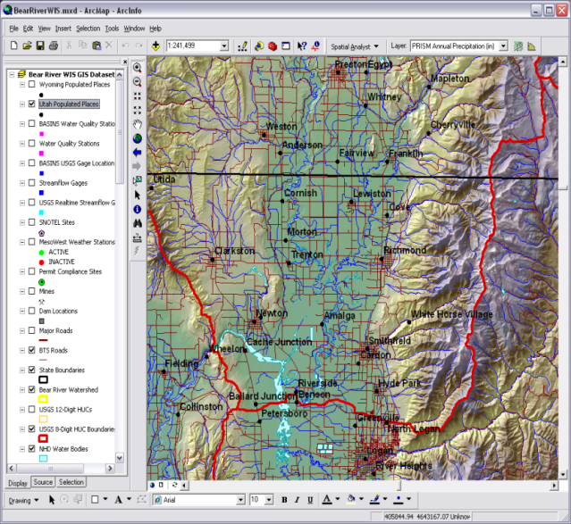
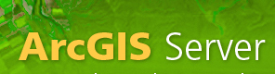
Point Observations Data
Internet Applications
Ongoing Data Collection
Historical Data Files
ODM Database
GetSites
GetSiteInfo
GetVariableInfo
GetValues
GIS Data
WaterML
WaterOneFlow
Web Service
Data presentation, visualization, and analysis through Internet enabled applications
HydroServer

Slide 6
HydroServer Regions
A region is an experimental watershed, research site, etc. for which data are published
Little Bear River Experimental Watershed
Reynolds Creek Experimental Watershed
T.W. Daniels Experimental Forest
Organizing concept for HydroServer
One or more ODM databases/WaterOneFlow services for a region
One or more spatial data services for a region

Slide 7
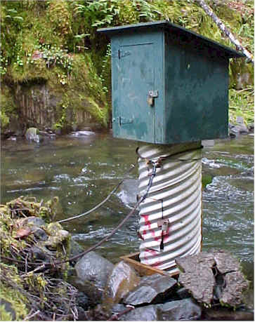
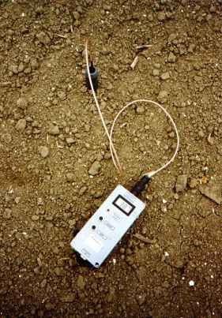
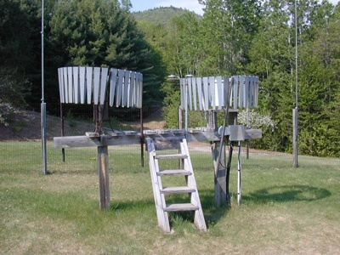
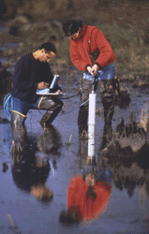
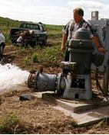
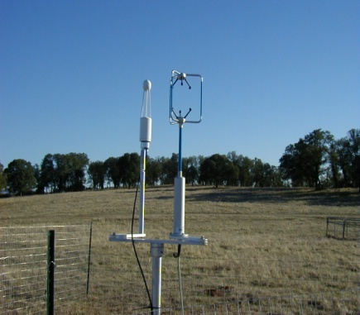
Water Observations Data
Water quantity
Soil water
Rainfall
Water quality
Groundwater
Meteorology

Slide 8
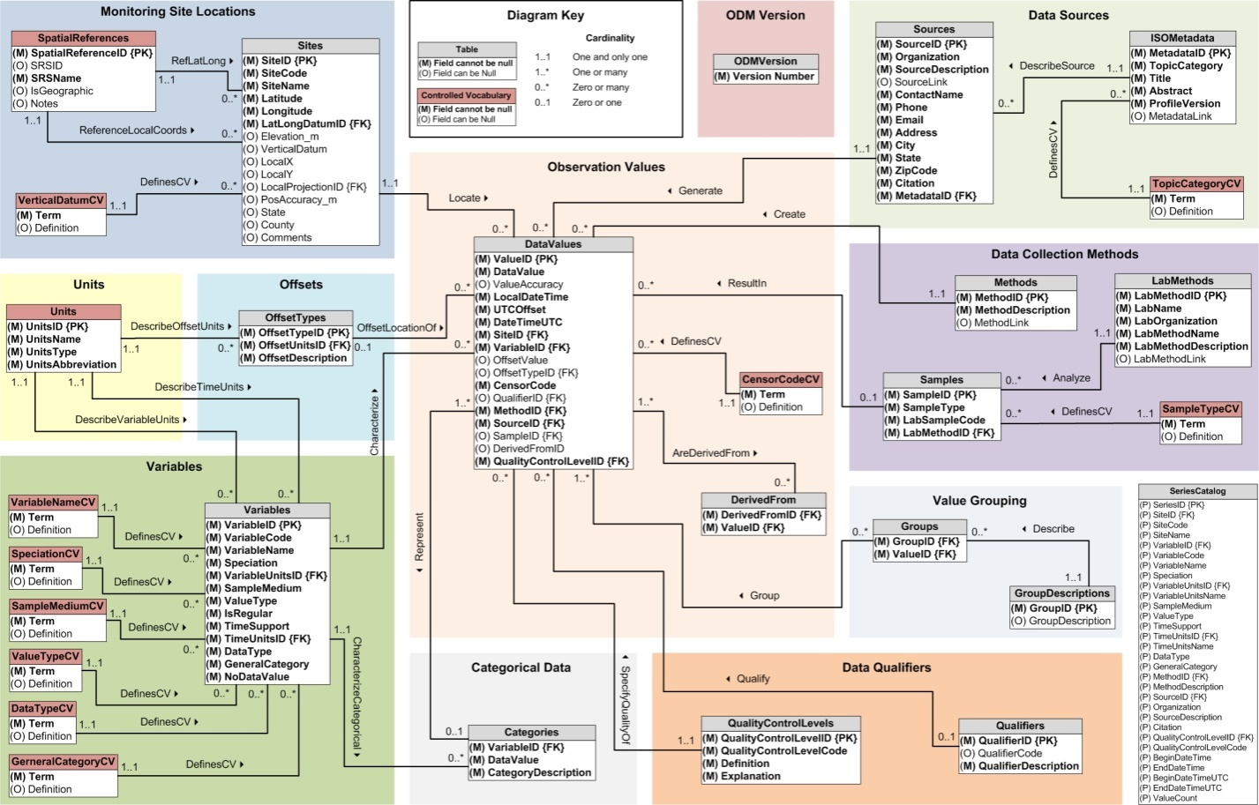
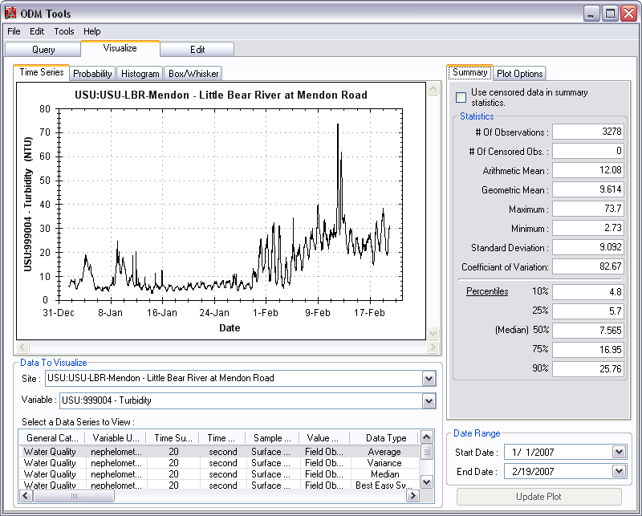
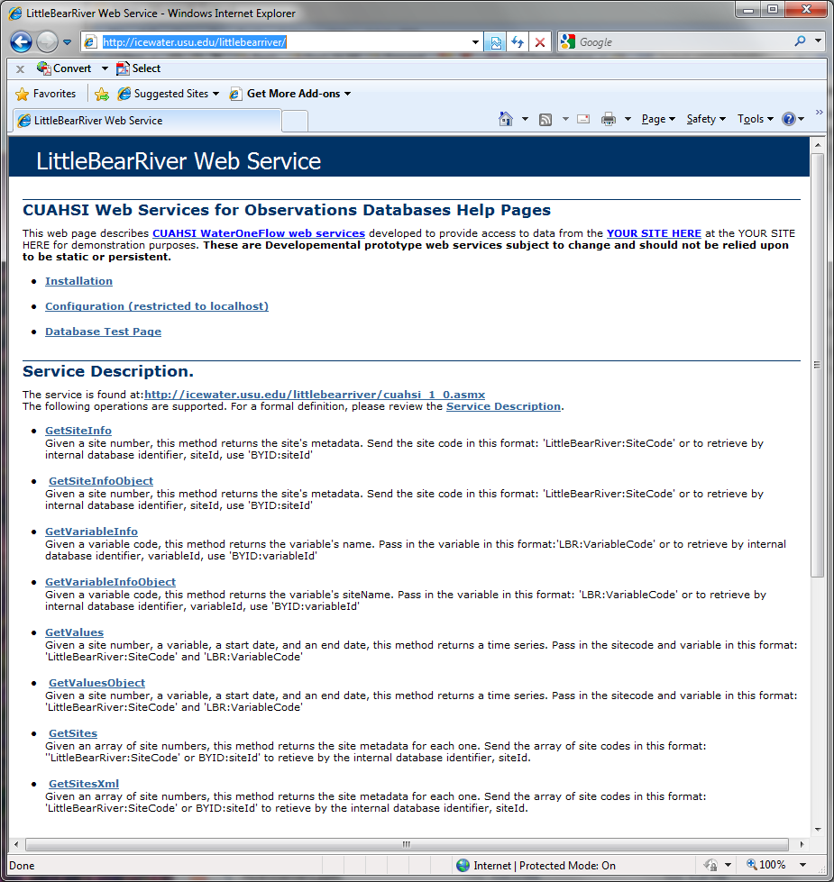
Publication of Point Observations
Observations Data Model (ODM)
ODM Tools
ODM Data Loader
ODM Streaming Data Loader
ODM Controlled Vocabularies
WaterOneFlow web services
Data are transmitted in WaterML format

Slide 9
Observations Data Model (ODM) A Relational Model at the Single Observation Level
“When”
Time, T
t
A data value
v_{i} (s,t)
s
“Where”
Space, S
V_{i}
“What”
Variables, V
Observations made at points
Metadata for unambiguous interpretation
Traceable heritage from raw measurements to usable information
Standard format for data sharing
Cross dimension retrieval and analysis

Slide 10
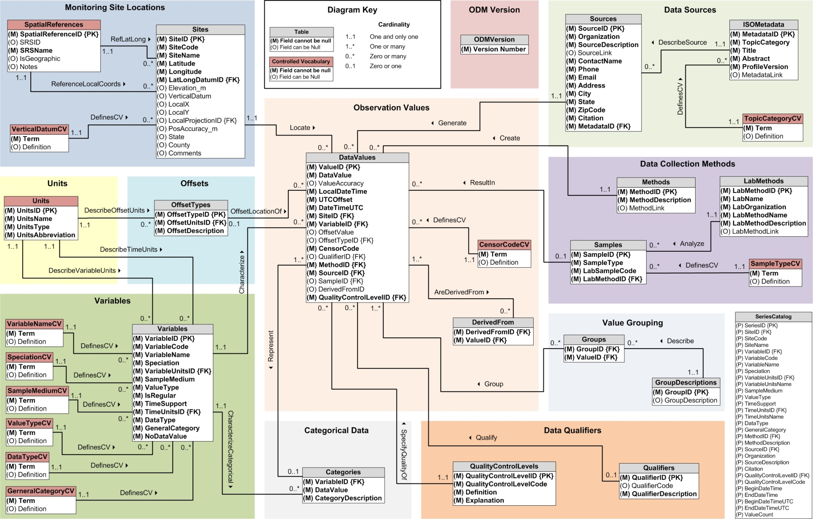
CUAHSI Observations Data Model http://his.cuahsi.org/odmdatabases.html
Horsburgh, J. S., D. G. Tarboton, D. R. Maidment and I. Zaslavsky, (2008), A Relational Model for Environmental and Water Resources Data, Water Resour. Res., 44: W05406, doi:10.1029/2007WR006392.
Notes:
In designing ODM we asked: What are the basic attributes to be associated with each single data value and how can these best be organized? This involved community survey at a workshop and by email and based on the feedback received we came up with the ODM schema illustrated, published last year in WRR
This is quite a detailed slide, but it is the entire schema. Few database designs are simple enough to fit the entire schema on one slide. This shows at the center the data values table and off to the sides, the ancillary or metadata tables that record.

Slide 11
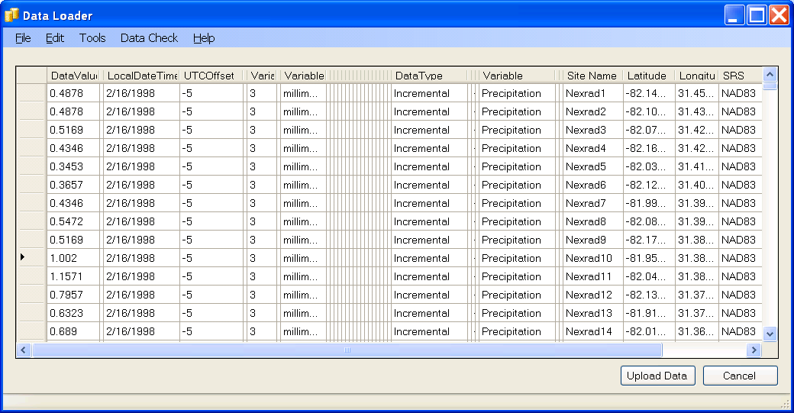
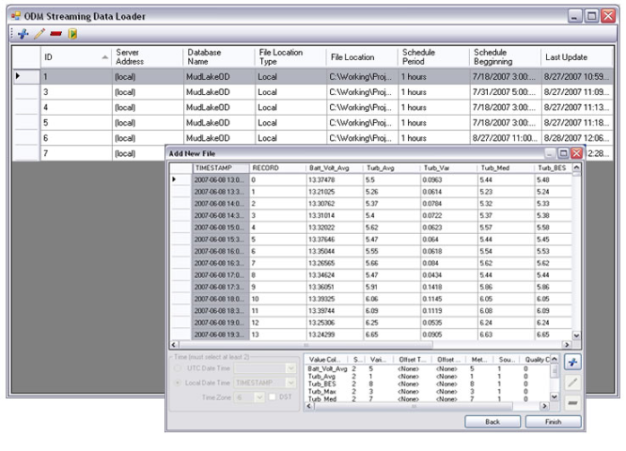
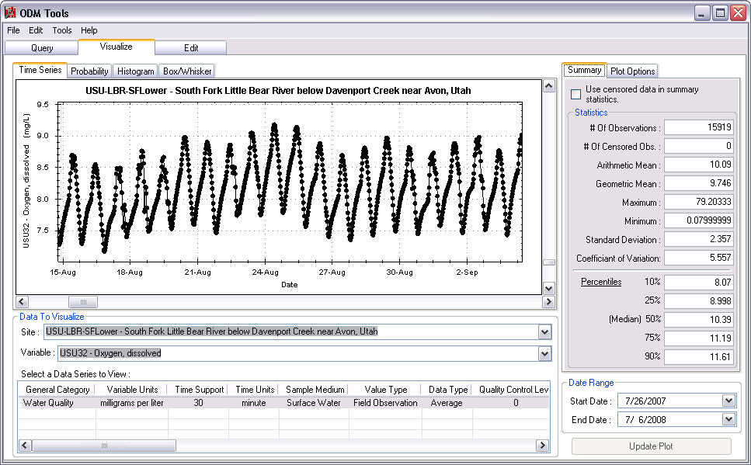
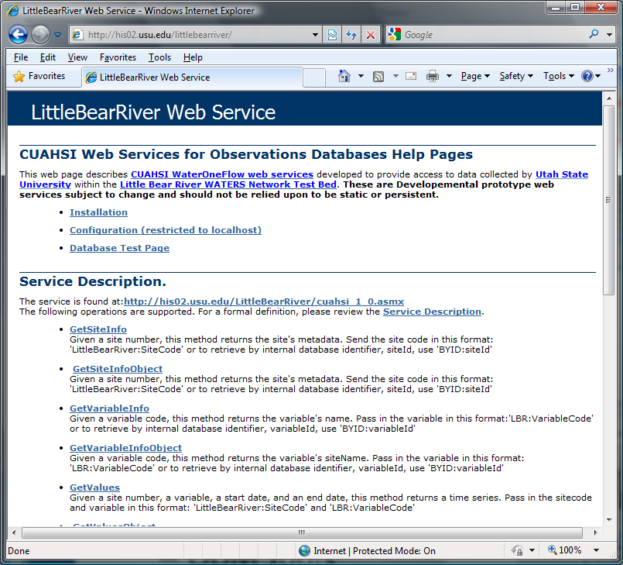
Publication of Point Observations Data
ODM Data Loader
Loading Data into ODM Databases
ODM Data Loader
ODM Streaming Data Loader
Editing and managing data
ODM Tools
Implementation of WaterOneFlow Web Services
ODM Streaming Data Loader
ODM Tools
Tools available at: http://his.cuahsi.org
WaterOneFlow

Slide 12

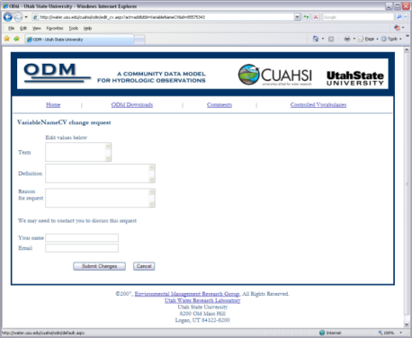

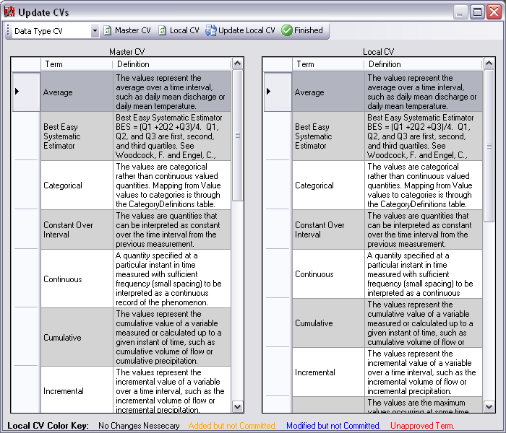
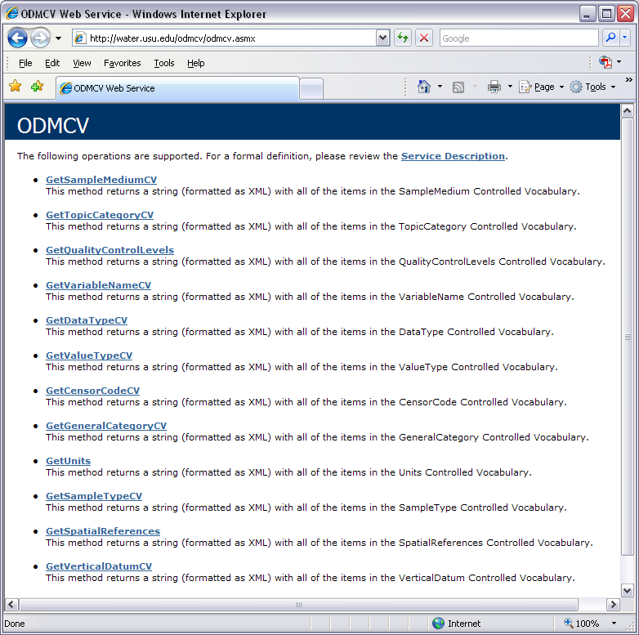
Dynamic Controlled Vocabulary Moderation System
ODM Data Manager
HIS CV Website
ODM
Tools
ODM Controlled
Vocabulary Moderator
XML
Master ODM Controlled Vocabulary
Local ODM
Database
ODM
Controlled Vocabulary
Web Services
Local
Server
http://his.cuahsi.org/mastercvreg.html

Slide 13
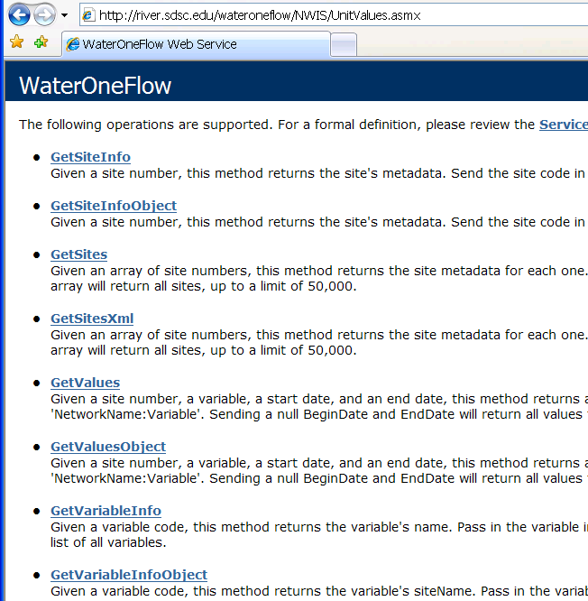
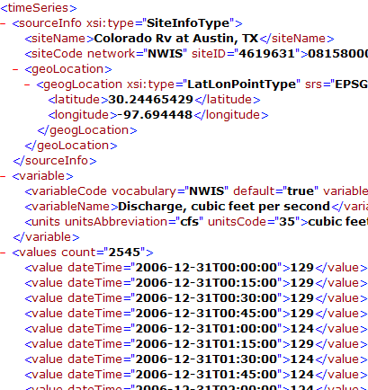
WaterML and WaterOneFlow
WaterML is an XML schema for communicating water data
WaterOneFlow is a set of web services based on WaterML
Set of query functions
Returns data in WaterML
Slide from David Valentine
Notes:
13

Slide 14
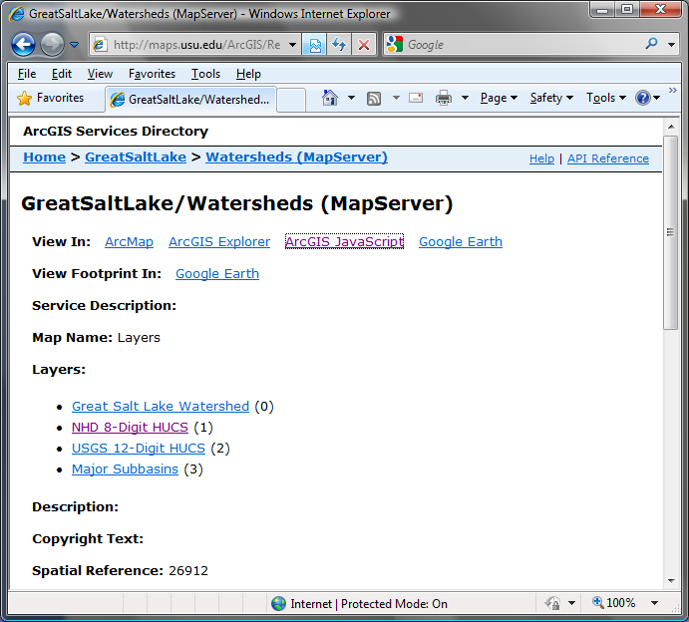
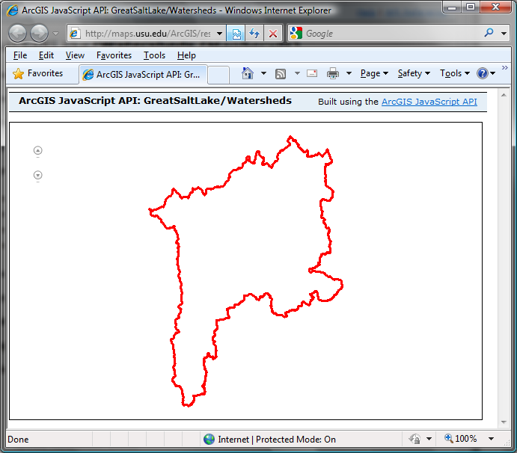
Publication of Spatial (GIS) Datasets
Publishing spatial datasets using ArcGIS Server
Using OGC standards that can be consumed by a number of GIS clients
WMS, WFS, WCS

Slide 15
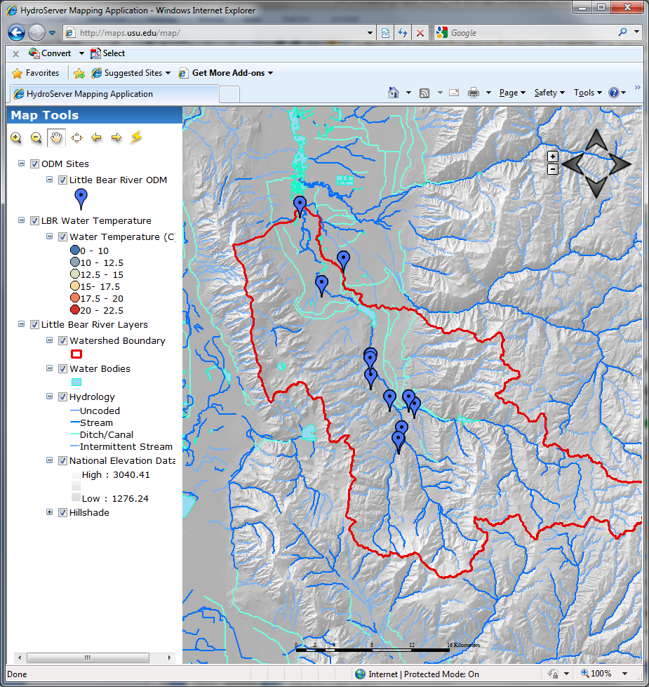
Data Presentation Via a Map Interface
Internet Map Server built using ArcGIS
Web browser client
Combine spatial data and observational data
Launch data visualization tools
Based on a “Region”
http://maps.usu.edu/map/

Slide 16
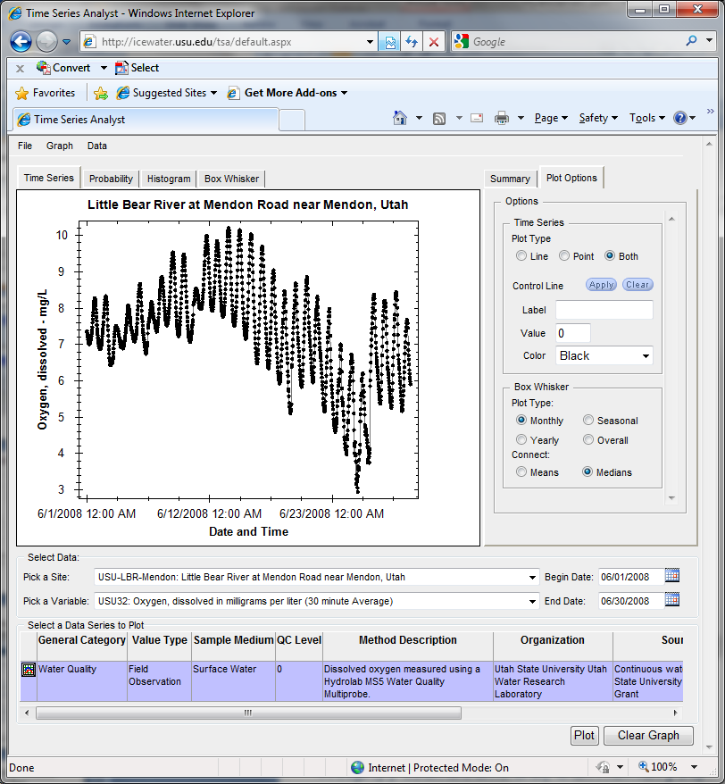
Data Preview, Visualization, and Analysis Time Series Analyst
Web Browser Client
Multiple ODM Database Support
Variety of plot types
Descriptive statistics
Linked to the map application
Data preview and download
http://icewater.usu.edu/tsa/

Slide 17
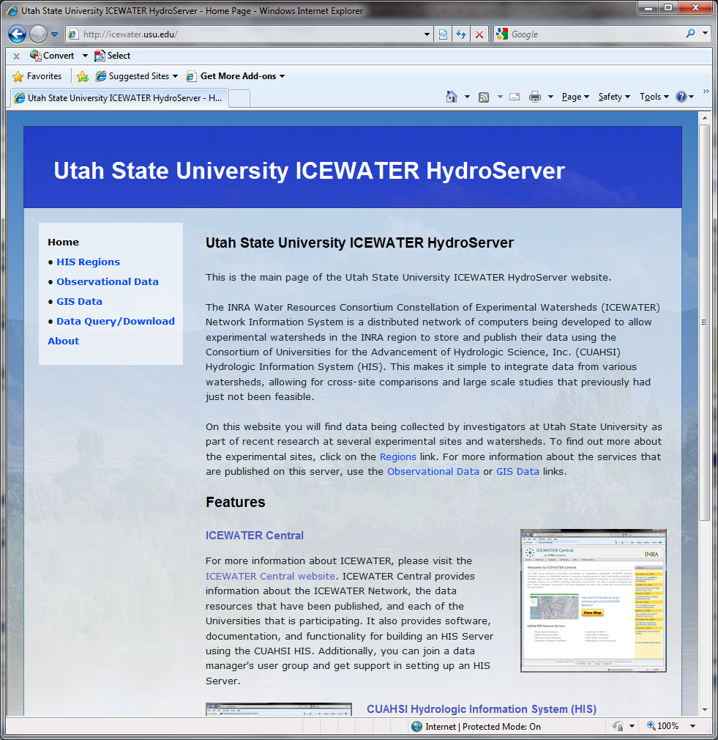
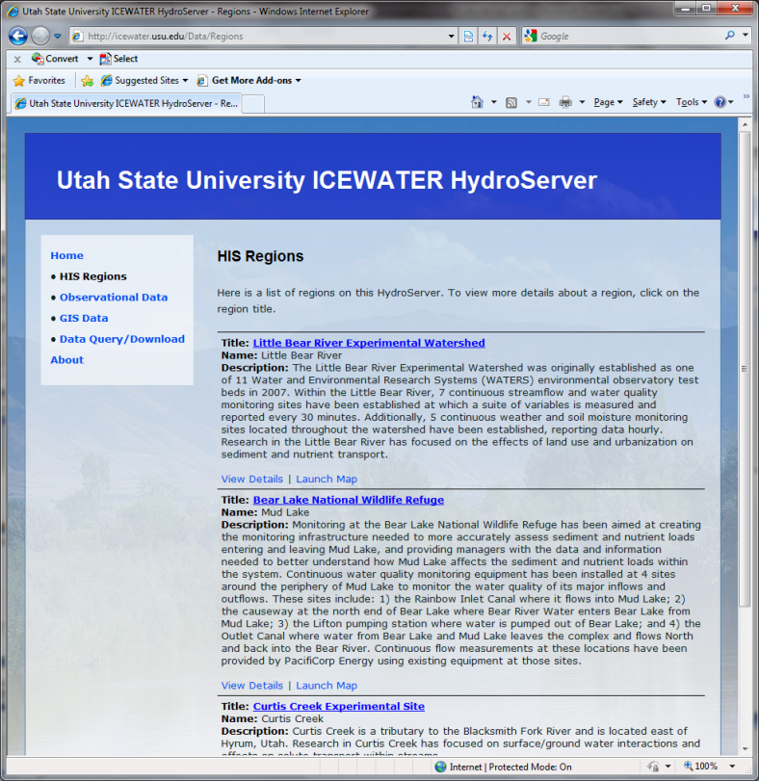
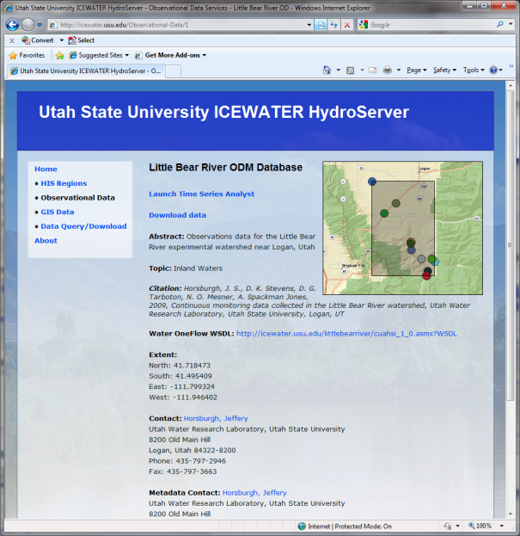
HydroServer Website
HydroServer home page
Observational data services
GIS data services
Online map
Time Series Analyst
Data Query and Download
http://icewater.usu.edu

Slide 18
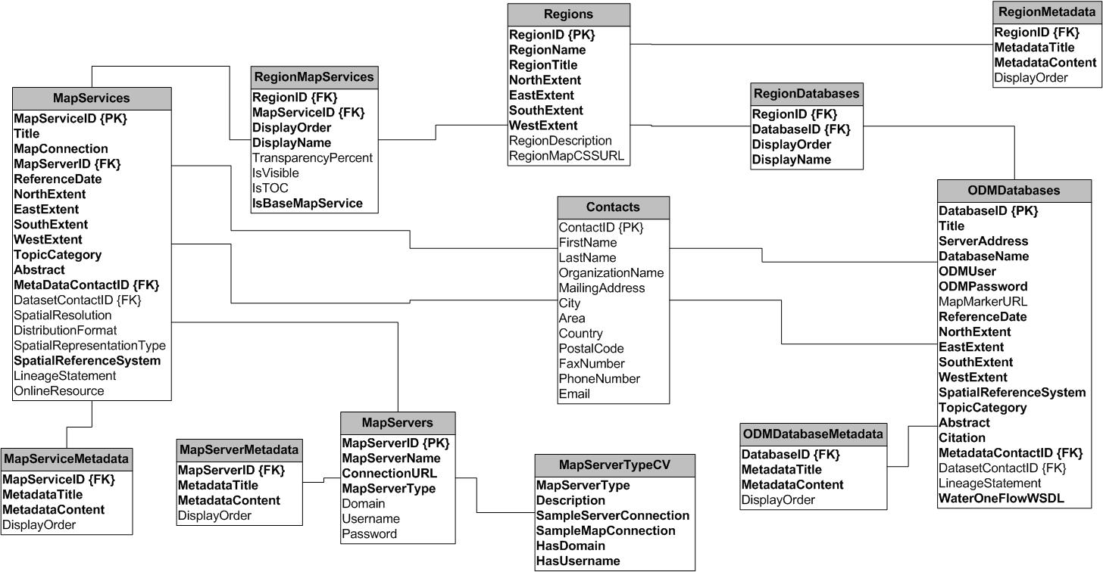
HydroServer Capabilities Database
HydroServer Capabilities Database Configuration Tool
Simple Windows application for creating metadata records in your database
Associating Regions with services and maps

Slide 19
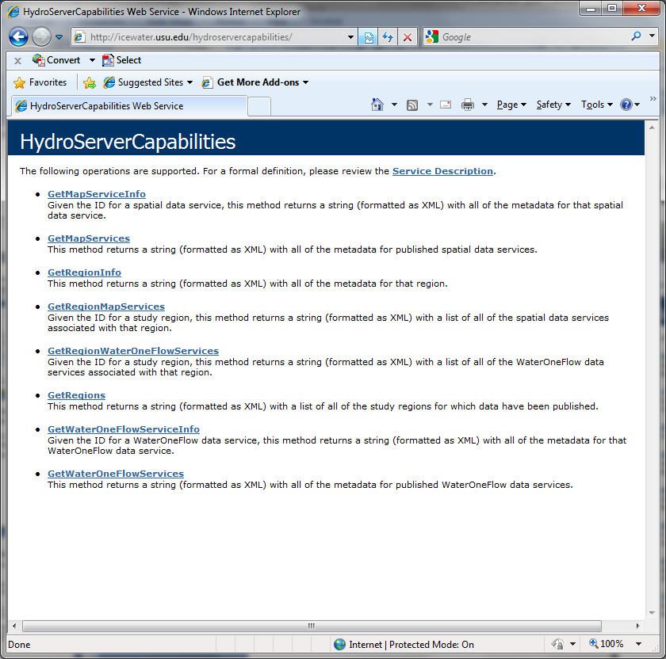
HydroServer Capabilities Web Service
Publish capabilities of each HydroServer
Observational data services
Spatial data services
Information transmitted in XML format
Supports automatic cataloging of available services at HIS Central
Makes HydroServers self describing

Slide 20
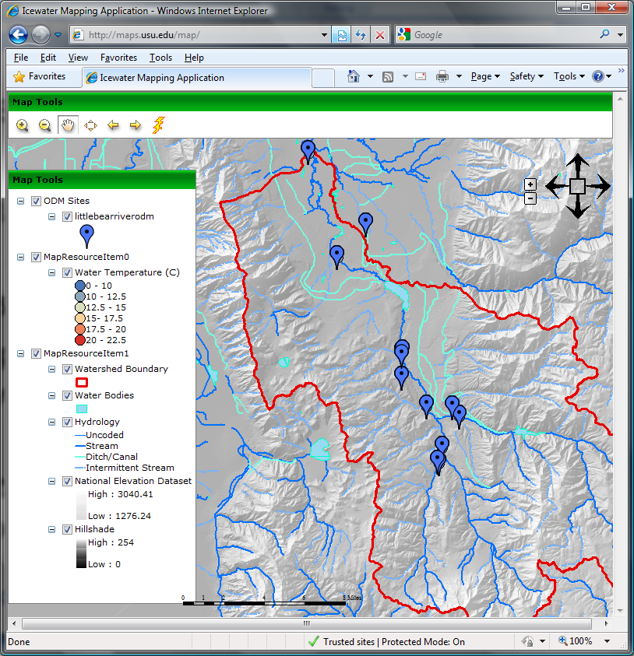
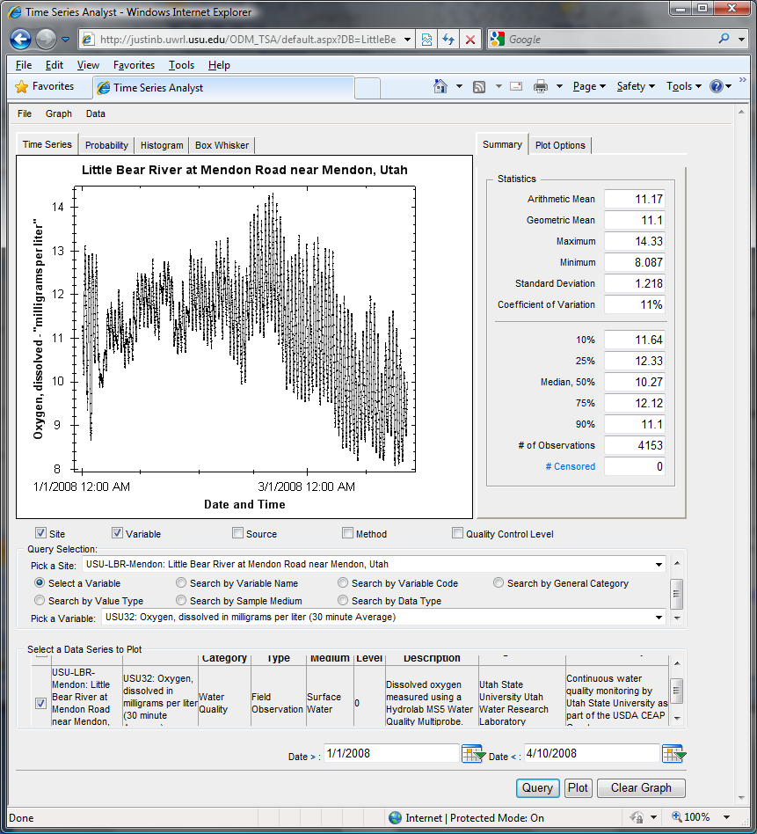
Capabilities Database Configuration Tool
WaterOneFlow
Services
HydroServer
Capabilities
Database
Spatial
Services
WaterOneFlow
WaterOneFlow
WaterOneFlow
ODM
ODM
ODM
ODM Databases and Web Services
ArcGIS Server Spatial Data Services

Slide 21
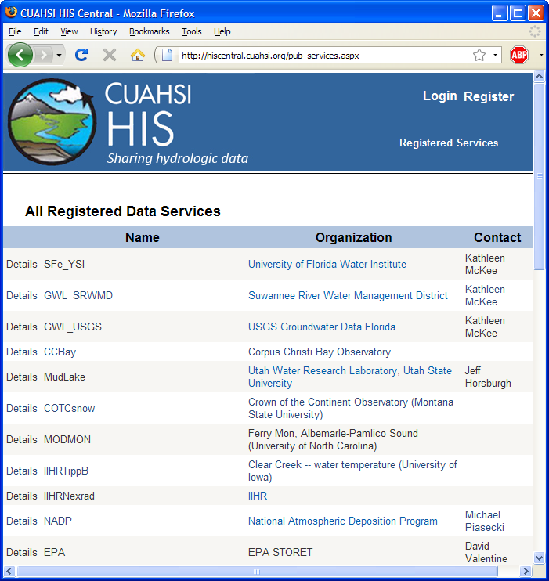
HIS Central
Publishers
Register a data service
Users
Find a data service
Components
Service registry
Metadata catalog
Ontology
Search services
http://hiscentral.cuahsi.org
Notes:
HIS Central keeps a listing of all registered web services, and also maintains a metadata catalog of site and variable information from those services to enable fast data searching.

Slide 22
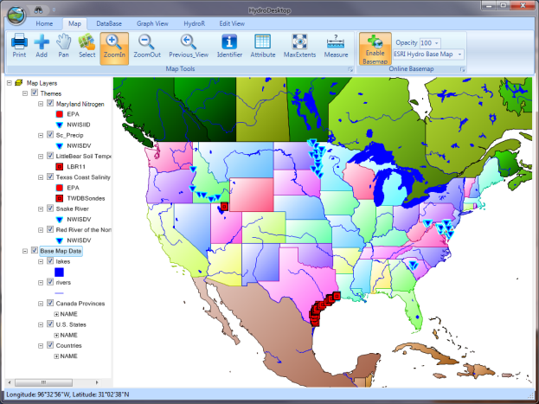
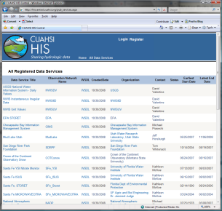
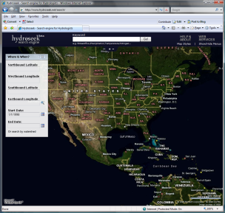
HydroServer Distributed Water Data Services
National Dataset Water Data Services
ODM
ODM
ODM
ODM
ODM
NWIS
STORET
DAYMET
SNOTEL
…
WOF
WOF
WOF
WOF
WOF
WOF
WOF
WOF
WOF
WOF
HydroDesktop
HIS Central
Metadata
Harvesting
Web Service Calls
WaterML
Desktop Analysis Software
Database API
Metadata
Catalog
R
Desktop Data
Repository
Search, Download, and Manage Data Subscriptions
Data Discovery
Calls
Metadata Services
MATLAB
Excel
Variable
Mapping
Visualize and Summarize (TSA)
Workflow
Convert Units
Ontology
Ontology
Services
Convert Formats and Export
Files
Import
HydroDesktop
Plug-ins
Files

Slide 23
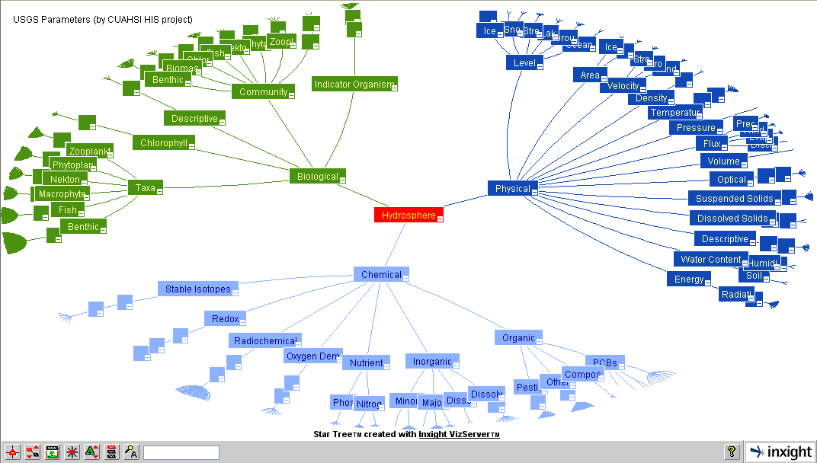
Hydrologic Domain Ontology to support concept based data discovery
Notes:
Generated by Dave V. It is the star tree for new ontology.

Slide 24
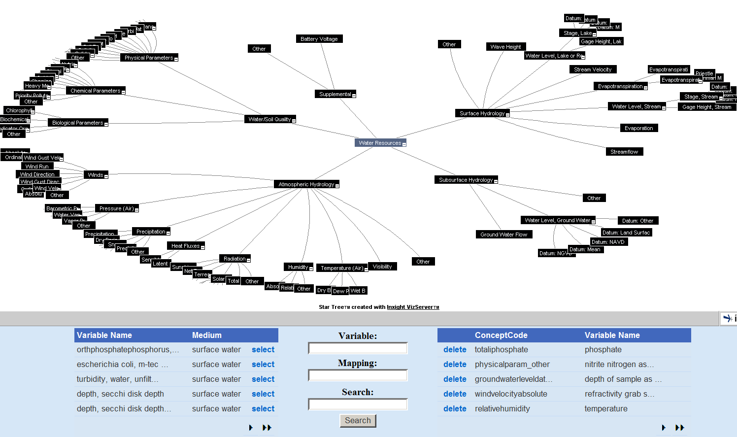
HydroTagger
Each VariableName is connected to a corresponding Concept

Slide 25
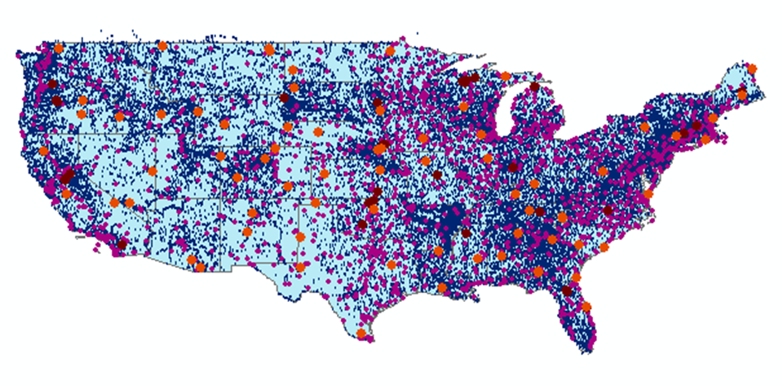
HIS Central Catalog
43 services
15,000 variables
1.8 million sites
9 million series
4.3 billion data

Slide 26
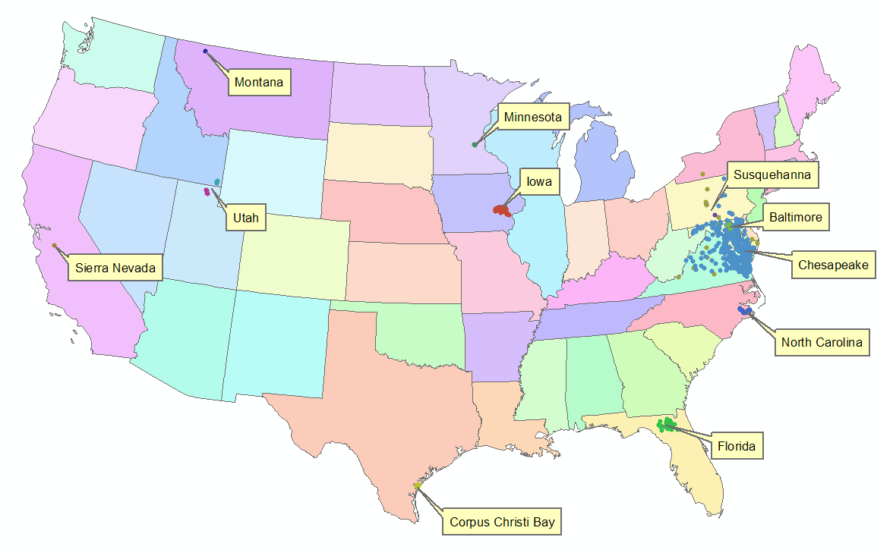


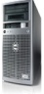

HydroServer Implementation in WATERS Network Information System
National Hydrologic Information Server
San Diego Supercomputer Center
11 WATERS Network test bed projects
16 ODM instances (some test beds have more than one ODM instance)
Data from 1246 sites, of these, 167 sites are operated by WATERS investigators

Slide 27
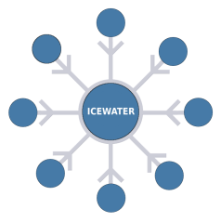

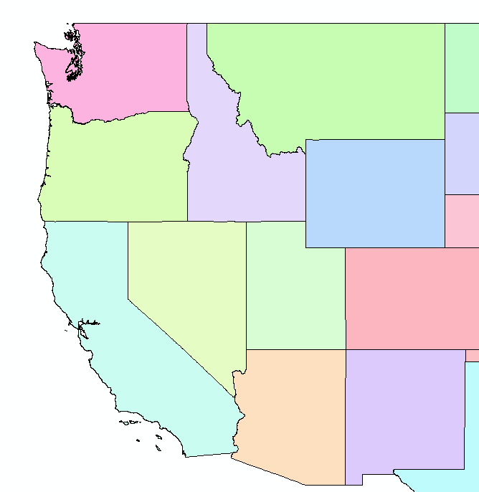













ICEWATER – A Regional HIS
ICEWATER – INRA Constellation of Experimental WATERsheds
Coalition of 8 universities
Point Observations
Stream gages
Water quality sampling
Weather stations
Soil moisture
Snow monitoring
Groundwater level/quality
Spatially Distributed Data
Land use/cover
Terrain
Hydrography
WA
MT
OR
ID
WY
AK
NV
UT
CO
CA
AZ
NM
http://icewater.inra.org

Slide 28

Texas Water
Data Services
10 services
7,010 variables
15,870 sites
645,566 series
23,272,357records

Slide 29
Summary
HydroServer provides a self contained autonomous data publication system
Local control of data, but universally accessible
Downloadable user (data publisher) configurable software stack that contains:
ODM and associated tools
WaterOneFlow web services
Geographic data sharing using WFS, WCS, WMS from ArcGIS server
Time Series Analyst
ArcGIS server based web map application
HydroServer Capabilities web service that publishes metadata about regions and services (observational and spatial)
Registering with HIS Central makes your data searchable

Slide 30
Questions?
CUAHSI
HIS
Sharing hydrologic data
http://his.cuahsi.org/
Support
EAR 0622374

